Slide 1
The Efficacy of Cognitive Motivational Behavior Therapy for Gambling Disorder
Edelgard Wulfert, Ph.D.
State University of New York at Albany
11-16-2017 (10:45-11:45am – Salon E)

Slide 2
Status of Treatment for Gambling
Legislative Lifetime prevalence:
Gambling disorder: ~0.5 – 1.0%
Problem gambling: 2.0 – 4.0%
Legislative changes: Proliferation of gambling venues (USA, CAN, AUS)
Urgent need for effective treatments
Treatment development in early stages
Notes:
2
Compared to addiction tx. in general, Tx for GD in its infancy

Slide 3
Research Findings
Many studies are conceptually weak (variables are not well defined)
Frequent methodological shortcomings
(insufficient controls)
→ Results are open to alternative interpretations
Notes:
3
Additionally, for clients at more severe levels of problem gambling more than one approach is sometimes necessary.
The bio-psychosocial-spiritual model encompasses all domains of functioning, and gives us a way of conceptualizing the many possible ways that a problem gambler can receive help.

Slide 4
Research Findings
Some well-controlled clinical trials exist
Treatments with proven effectiveness:
Cognitive Behavior Therapy (CBT)
Motivational Interviewing (MI)
Concern:
High attrition (treatment & follow-up)
Notes:
4
Additionally, for clients at more severe levels of problem gambling more than one approach is sometimes necessary.
The bio-psychosocial-spiritual model encompasses all domains of functioning, and gives us a way of conceptualizing the many possible ways that a problem gambler can receive help.

Slide 5
Examples from the Literature
Cognitive Behavioral Therapy (CBT)
(Sylvain, Boisvert & Ladouceur, 1997)
Randomized gamblers to CBT vs. wait list
~ 1/3 dropped out from CBT
~ 1/2 made good progress
~ only 1/3 maintained treatment gains over 1 year
Notes:
5
Additionally, for clients at more severe levels of problem gambling more than one approach is sometimes necessary.
The bio-psychosocial-spiritual model encompasses all domains of functioning, and gives us a way of conceptualizing the many possible ways that a problem gambler can receive help.

Slide 6
Examples from the Literature
Purely Cognitive Therapy (CT)
(Ladouceur et al., 2001)
Replicated study with CT vs. wait list
Close to 1/2 dropped out of treatment
The other 1/2 made good progress and maintained treatment gains
Notes:
6
Additionally, for clients at more severe levels of problem gambling more than one approach is sometimes necessary.
The bio-psychosocial-spiritual model encompasses all domains of functioning, and gives us a way of conceptualizing the many possible ways that a problem gambler can receive help.

Slide 7
Examples from the Literature
Motivational Interviewing (MI)
(Hodgins, Currie & El-Guebaly, 2001)
Compared effects of
- self-help workbook alone or
- combined with a brief phone MI session
MI led to greater reduction in gambling
Effect dissipated over 12 months
Notes:
7
Additionally, for clients at more severe levels of problem gambling more than one approach is sometimes necessary.
The bio-psychosocial-spiritual model encompasses all domains of functioning, and gives us a way of conceptualizing the many possible ways that a problem gambler can receive help.

Slide 8
Summary of Current Treatment Status
CBT and MI are effective treatments for gambling problems
However, gamblers are ambivalent about treatment and tend to drop out
Need to develop treatments to engage and retain patients in treatment
Notes:
8
Additionally, for clients at more severe levels of problem gambling more than one approach is sometimes necessary.
The bio-psychosocial-spiritual model encompasses all domains of functioning, and gives us a way of conceptualizing the many possible ways that a problem gambler can receive help.

Slide 9
Cognitive-Motivational Behavior Therapy (CMBT)
Empirically developed and researched psychotherapy (NIMH funded)
CMBT integrates components of:
Motivational Interviewing (MI)
Cognitive Behavioral Therapy (CBT)
Behavior Therapy & Skills Training
Relapse Prevention

Slide 10
Aims of CMBT
Generate motivation to stay in treatment (ambivalence → drop-out)
Correct cognitive distortions (cognitions → behavior; magical solutions)
Teach behavioral skills (coping & problem solving skills)
Develop a relapse prevention plan
(lapse vs. relapse)

Slide 11
MI Treatment Component
Motivational Interviewing
Client-centered counseling style:
Collaborative
Non-judgmental
Evocative (directive)
Helps clients resolve ambivalence and engages them in treatment

Slide 12
Increasing Motivation Through Assessment-Based Feedback
Presenting and Discussing Feedback:
Client receives written summary of assessment results
Feedback increases client’s awareness of the full consequences of gambling
Notes:
The feedback report gives a concise summary of clients gambling, including frequency, duration, number of symptoms, desire to change, and comparison to other gamblers. In our experience, many gamblers have never really considered their gambling in this way, and are often surprised by the results. The clients reaction is a key indicator of which aspects of their behavior are most bothersome. This gives the therapist information on what to focus on in terms of motivational enhancement.

Slide 13
Decreasing Ambivalence via Decisional Balance
Good Not So Good
High Feeling Debt
Way to get money Heartache, Stress
Social Activity Sleepless nights
Losing friends
Becoming withdrawn
Loss of Self-esteem Anxiety, Depression
Notes:
The decisional balance is a useful technique in highlighting the motivation for and consequences of gambling. Similar to the feedback report, when this information is presented side by side it allows the client to weigh both sides of their behavior to come to an informed decision about what they would like to do in treatment.
Play an example.

Slide 14
Increasing Motivation through Value/Behavior Discrepancies
Values Exercise:
Client selects important values from a list (e.g., hard-working, good provider, good parent, trust-worthy…)
Therapist facilitates discussion of discrepancy between espoused values and gambling behavior
Notes:
Many problem gamblers often lose sight of which values they hold as most important (e.g., family, success, honesty). By engaging the client in a discussion of their values, and then asking how gambling impacts these valUes, we ask the client to evaluate their behavior as compared to their core beliefs and goals in life.

Slide 15
Treatment Goal Setting
When ambivalence has been resolved, client is asked to set treatment goals
Discuss possible hurdles and solutions
Abstinence vs. “controlled gambling”
Proceed to next treatment phase: CBT
Cognitive and behavioral interventions
Notes:
Some request harm reduction (e.g., “I don’t want to stop”, “I just want to control my gambling”). From our own conviction, we’ve never had anyone succeed at so called “controlled gambling”. However, if you tell a client they must quit this increases resistance and many do not return to treatment. Through motivational enhancement, we increase awareness of money spent, time, and frequency of gambling, inconsistencies between personal values and gambling behavior, as provide psychoeducation on pathological gambling in general (urges, thoughts). Since the relationship continues to develop through this process, when the individual fails to meet the goal they set ($50 per week, only on weekends, etc.), the therapist can enter into a realistic conversation with the client about their goal without defensiveness and suggest alternative goals (try not gambling for a week).
Expectancies of the client should be same as the provider!

Slide 16
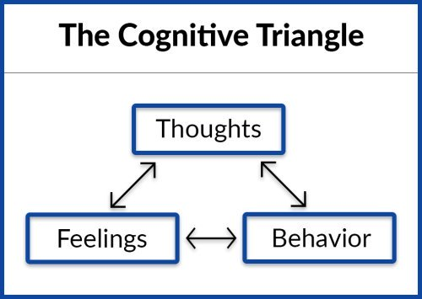
CBT Model
Reciprocal relationships between components
Notes:
Dysfunctional beliefs lead to dysfunctional feelings and behavior. To change dysfunctional behavior (e.g., gambling), it is necessary to change beliefs.

Slide 17
Cognitive Interventions
Identifying (external and internal) high-risk situations (triggers) that instill thoughts/urges to gamble
Identifying cognitive distortions and automatic thoughts (e.g., gambler’s fallacy)
Using cognitive restructuring to correct false beliefs (Socratic method)
Identifying and correcting Core Beliefs (“I’m a failure” → money = love, power, respect = “magical solution to life’s problems”)
Notes:
Triggers: External: free coupons; convenience store 7/11 for coffee → scratch-off tickets.
Internal: mood states (desire to escape)
Gambler’s fallacy: past determines future (roulette ball has no memory!) // superstitions (dice: hard/slow) // misunderstanding chance vs. skill
Cogn.Restructuring: Socratic dialogue: You seem to be assuming … // please explain how… why… // how could you verify or disprove this assumption?

Slide 18
Behavioral Elements of CBT
Teaching clients behavioral skills to
avoid gambling
Avoiding high-risk situations
Managing Urges (“urge surfing”), stress, neg. mood
Problem solving (financial, work, relationships)
Addressing relapse prevention
New behaviors, support networks, booster sessions

Slide 19
Research on CMBT Efficacy
Study 1 (exploratory – open trial)
Comparing CMBT and TAU (trmt. as usual)
CMBT:
9 males (horse racing, BJ, craps gamblers)
(2 males and 1 female did not participate in research)
Mean age 43 yrs (range: 27-56); 6 Cauc., 3 AA.
All met ≥ 7 of 10 DSM-IV criteria; Mean SOGS 16
TAU: (data retrieved from archives)
12 males
Mean age 44 yrs (range: 30-59); 10 Cauc., 1AA, 1NA
All met ≥ 7.5 of 10 DSM-IV crit.; Mn SOGS 15

Slide 20
Attrition: CMBT vs. TAU
CMBT: 9 of 9 retained
TAU: 8 of 12 retained
χ² (1, N=20)=8.05, p=.005
SOGS (before and after treatment):
CMBT: Pre M=15.9 (SD 3.6); Post M=1.2 (SD 2.9)*
TAU: Pre M=14.0 (SD 4.2); Post M=7.8 (SD 6.3)*
Rep. Measures ANOVA (CMBT 3, 6, 12 mos):
Time: Hot.Trace 7.25, F(1,15)=108.79, p<.001
Time*Group: Hot.Trace 1.17, F(1,15)=17.61, p=.001
DSM IV criteria (analogous findings)
CMBT: Pre M=8.1 (SD 0.9); Post M=1.3 (SD 1.7)*
TAU: Pre M=7.5 (SD 1.2); Post M=4.8 (SD 3.0)*
Time: p<.001 and Time*Group Effect p=.002
* CMBT:TAU difference: p <.01
9 males (horse racing, BJ, craps gamblers)
(2 males and 1 female did not participate in research)
Mean age 43 yrs (range: 27-56); 6 Cauc., 3 AA.
All met ≥ 7 of 10 DSM-IV criteria; Mean SOGS 16
TAU: (data retrieved from archives)
12 males
Mean age 44 yrs (range: 30-59); 10 Cauc., 1AA, 1NA
All met ≥ 7.5 of 10 DSM-IV crit.; Mn SOGS 15

Slide 21
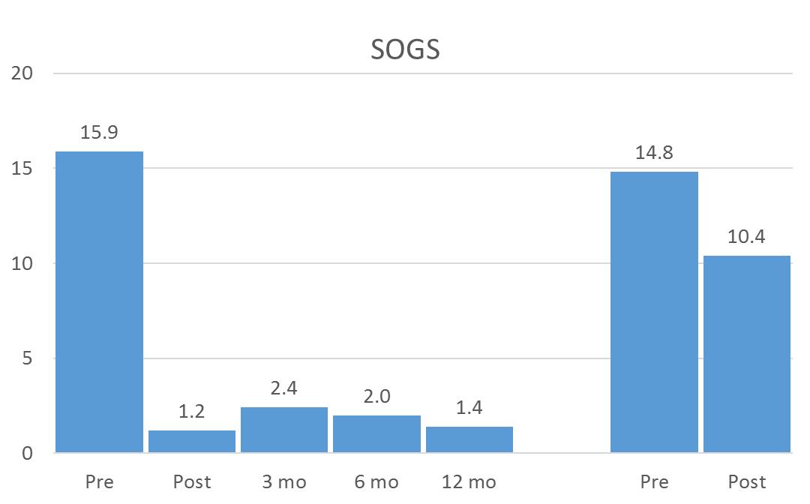
South Oaks Gambling Screen
CMBT
TAU

Slide 22
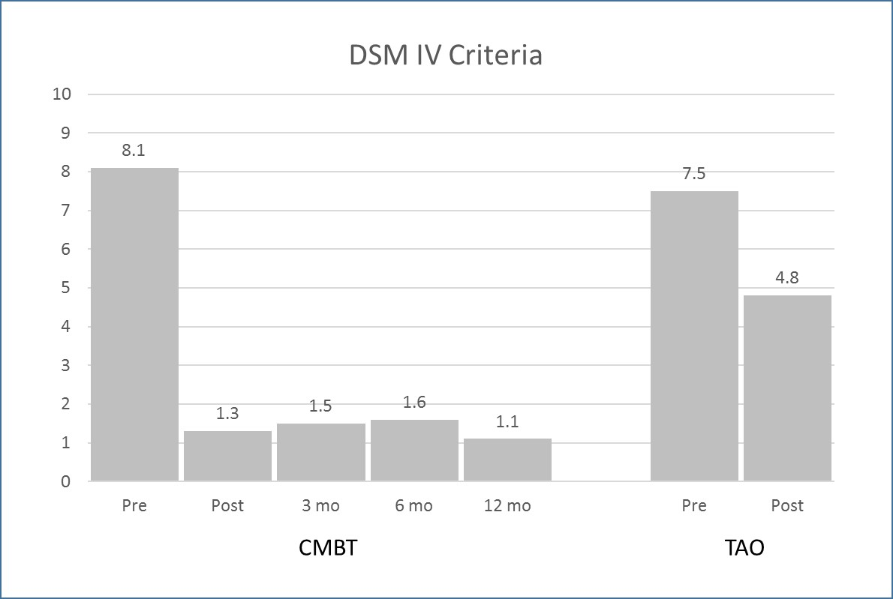
DSM IV Criteria

Slide 23
Research on CMBT Efficacy (RCT)
Study 2 (NIMH-funded Randomized Controlled Trial)
Comparing CMBT and GA (Gamblers Anonymous)
Sample:
N=46 (32 males, 14 females)
Mean age 43 yrs (range: 24-70)
39 Caucasian, 5 Afr.A., 1 Hisp., 1 Asian
Mean # DSM-IV criteria = 8; Mean SOGS 12
Randomized to Groups
CMBT: 16 males, 7 females
GA: 16 males, 7 females

Slide 24
Attrition: CMBT vs. GA
CMBT: 22 of 23 retained; attrition 4.3%
GA: 14 of 23 retained; attrition 60.9%
Fisher’s Exact Test, p=.005
DMS IV: Patients who still met criteria for PG
after treatment /3 mos/6 mos follow-up:
CMBT: Post: 39% / 3 mos: 22% / 6 mos: 17%
GA: Post: 70% / 3 mos: 57% / 6 mos: 65%
Rep. Measures ANOVA (CMBT):
Time*Group: Wilks λ .748, F(3,42)=4.73, p=.006
9 males (horse racing, BJ, craps gamblers)
(2 males and 1 female did not participate in research)
Mean age 43 yrs (range: 27-56); 6 Cauc., 3 AA.
All met ≥ 7 of 10 DSM-IV criteria; Mean SOGS 16
TAU: (data retrieved from archives)
12 males
Mean age 44 yrs (range: 30-59); 10 Cauc., 1AA, 1NA
All met ≥ 7.5 of 10 DSM-IV crit.; Mn SOGS 15

Slide 25
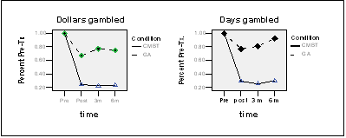
Percent Reduction in $$ Lost Gambling and Days Gambled
From Pre-Treatment to 6 mos follow-up:
% Reduction in dollars lost: CMBT = 79% vs. GA = 23%
% Reduction in days gambled: CMBT = 72% vs. GA = 8%
ITT: Sign. for Condition, Time, Interaction (p<.01)

Slide 26
Additional Findings:
No gender difference in CMBT:
Men and women benefited equally from treatment
Significant gender difference in GA:
None of the 7 women benefited from GA
The few men who remained with GA did as well as the men in CMBT

Slide 27
Effectiveness Trial (RCT) CMBT vs. CBT
Study 3 (NIMH-funded Randomized Controlled Trial)
Comparing CMBT and GBT
Sample:
N=62 (44 males, 18 females)
Mean age 49 yrs (range: 20-76)
51 Caucasian, 1 Afr.A., 2 Hisp., 3 Asian, 5 Other
Mean # DSM-IV criteria = 7; Mean SOGS 9
Randomized to Groups
CMBT: 30 (21 males, 9 females)
GBT: 32 (23 males, 9 females)

Slide 28
Preliminary Findings
DMS IV diagnostic criteria:
At the start of the trial, all patients met dx. criteria for pathological gambling
Patients in both CBT and CMBT improved significantly, with mean number of dx. criteria in the non-clinical range.
CMBT led to greater mean reductions in dx. criteria at 3, 6 and 12 mos follow-up (p≤.04)
F(1, 176.62)=467, D=400, p=.032

Slide 29
Preliminary Findings
Completion of all 12 sessions (Yes/No):
CMBT: 21 of 30 (70%) completed all 12 sessions
CBT: 18 of 33 (55%) completed all 12 sessions
Is there a pattern to attrition?
CMBT emphasizes MI as an early engagement mechanism to prevent attrition

Slide 30
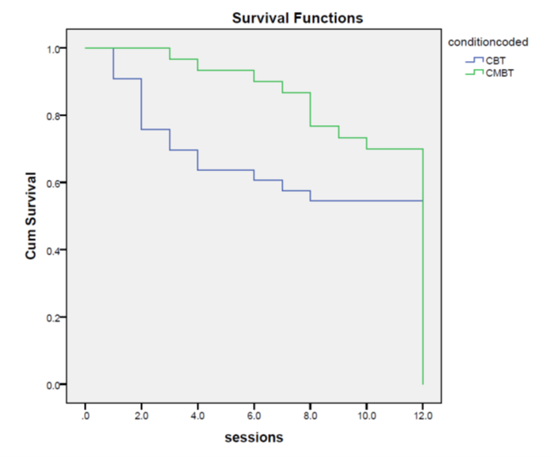
Survival Analysis of # of Sessions Completed
Patients in CBT dropped out at higher rate than those in CMBT, particularly early in treatment.
[Breslow (1) = 4.124, p=.042)]

Slide 31
Questions that need to be answered:
Completion vs. benefit from treatment
Is there a dose-response relationship?
Did patients with certain characteristics benefit more from one treatment than the other?
Matching hypothesis
Did therapist competence play a role in outcomes or attrition?
Therapist effect
CBT: % Retention by Thpsts: 37 – 73 – 63 –63
CMBT: % “ 75 – 75 – 67

Slide 32
Additional Observations:
After-care is important!
Refer clients to group (GA, self-help grp)
Provide booster sessions
Refer clients for treatment of comorbid psychological problems

Slide 33
Thank you for your attention.
Questions?
Comments?
Contact Info: EWulfert@albany.edu

