Slide 1
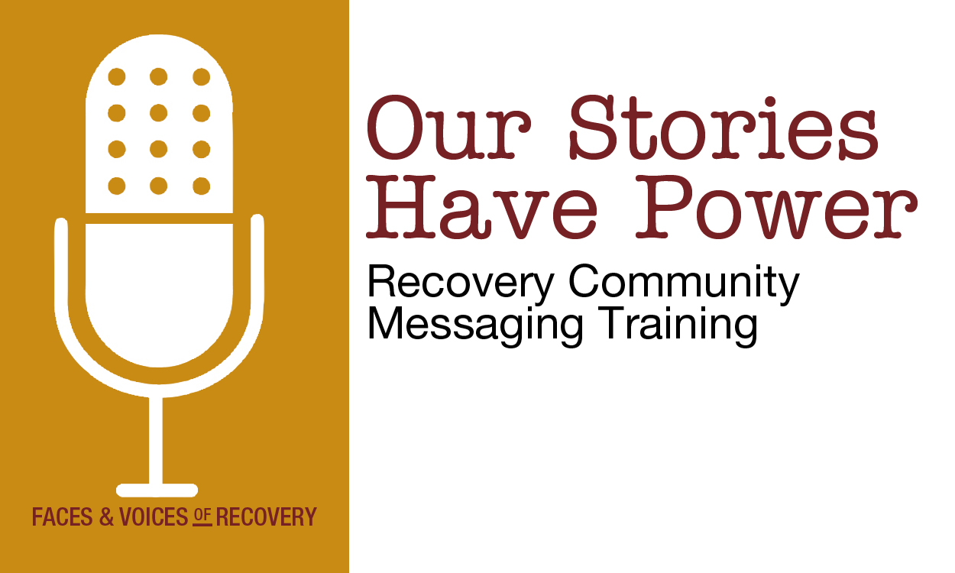
New York Council on Problem Gambling Conference
Ruth Bowles, CPP-G
Rockland Council on Alcoholism and Other Drug Dependence, Inc.

Slide 2
Our Goals
Learning about messaging
Learning how to tell your recovery story to your friends and family
Learning how to use recovery messages in all parts of your life, including representing the organized recovery community in the media and other public places

Slide 3
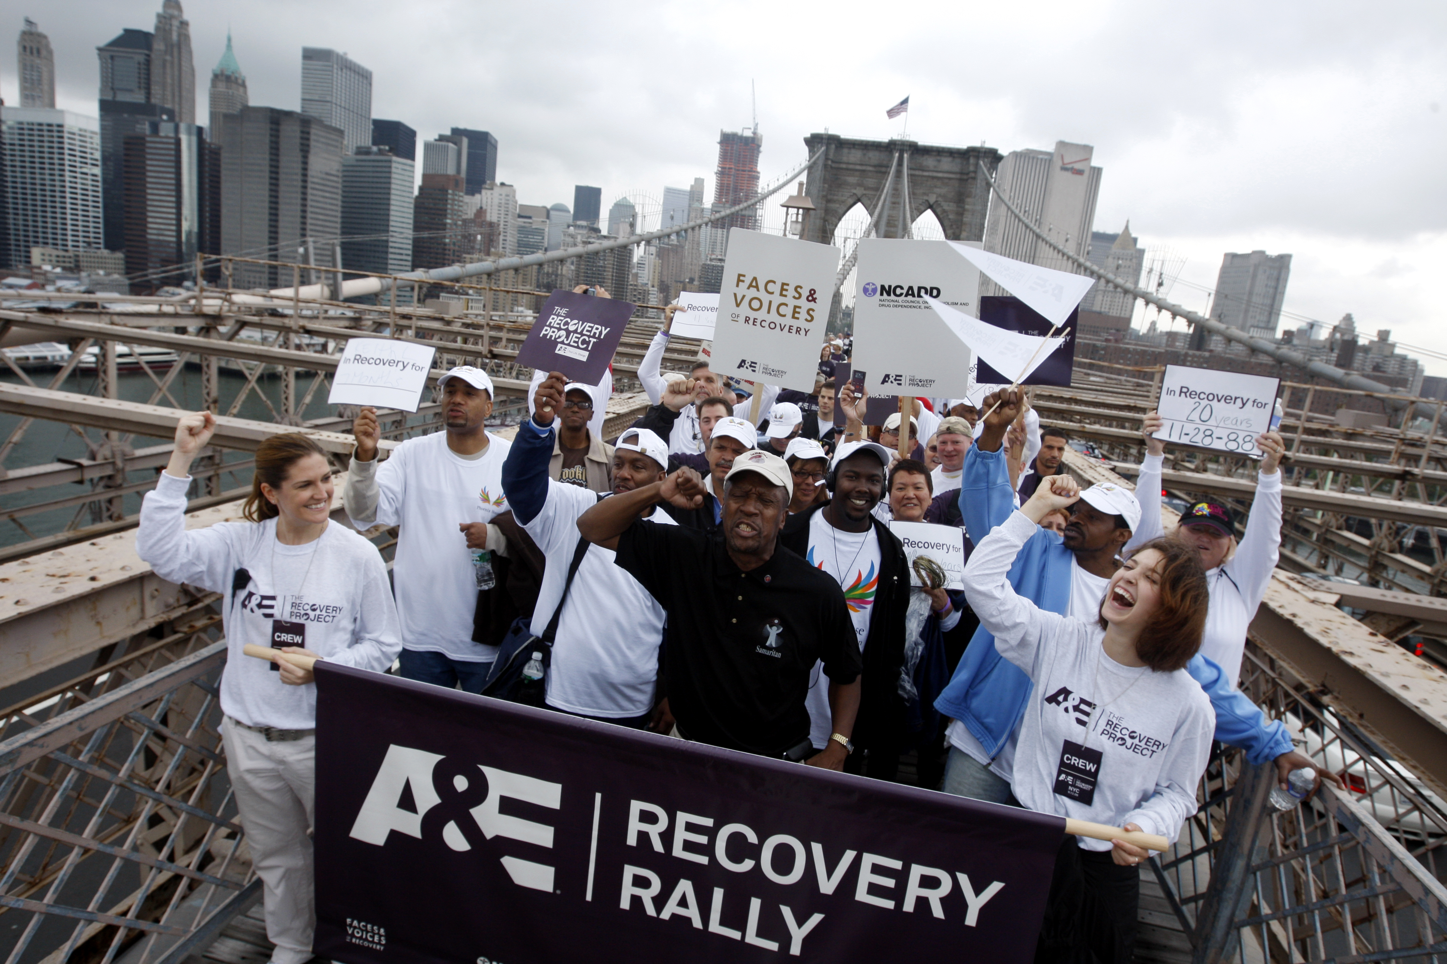
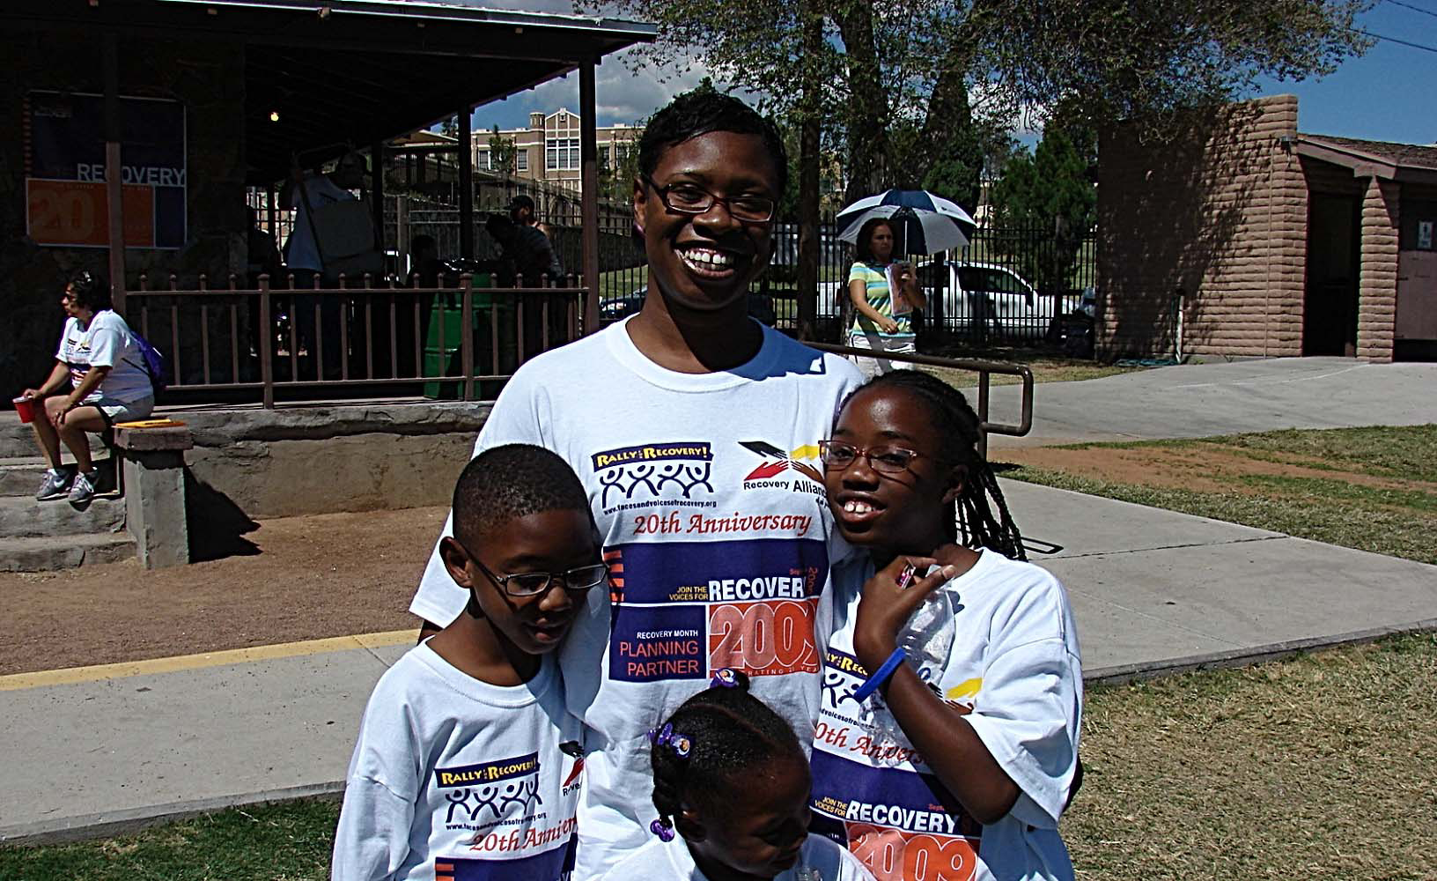
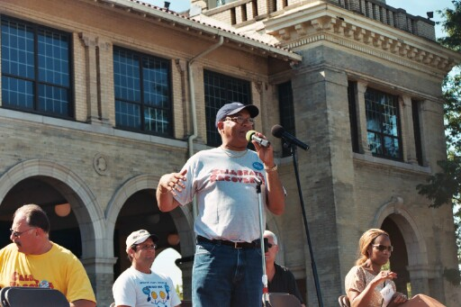
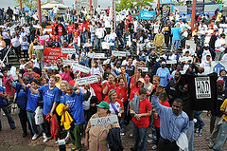
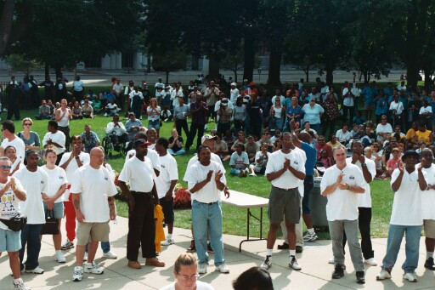
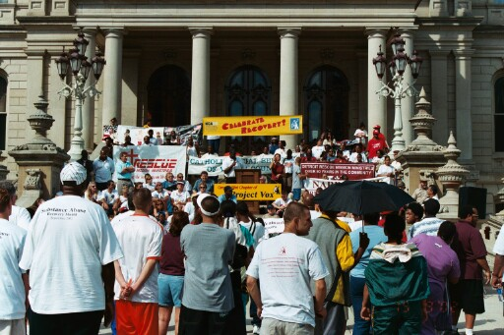
Recovery Community
People in recovery from addiction, their family members, friends and allies

Slide 4
Faces & Voices of Recovery
Organizing and mobilizing (1) the millions of Americans in long-term recovery from addiction; (2) our families, friends, and allies to speak with one voice.
Changing public perceptions of recovery.
Promoting effective public policy in Washington, D.C. and in all 50 states.

Slide 5
Faces & Voices of Recovery
  Keeping a focus on the fact that recovery works and is making life better for over 20 million Americans.
Raising the national profile of the recovery movement
Supporting local recovery advocacy and recovery community organizations
It is our mission to bring the
power and proof of recovery
to everyone in America!

Slide 6
Many Pathways to Recovery
6
Mutual support/mutual assistance
Professional treatment
Faith/religious
Medication-assisted
Criminal justice/Drug Court
“Natural” or on your own
And many more

Slide 7
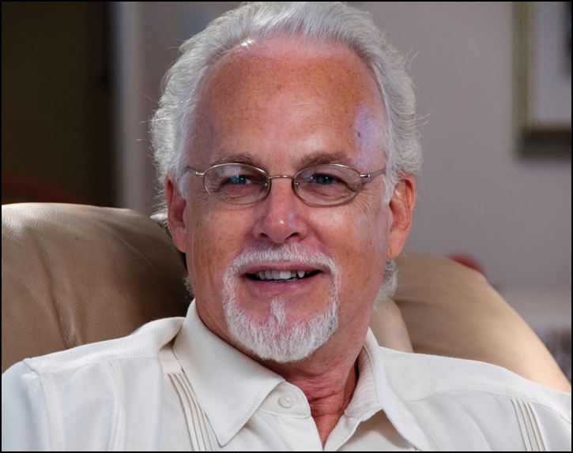
Message of Hope
“Many of us have carried a message of hope on a one-to-one basis; this new recovery movement calls upon us to carry that message of hope to whole communities and the whole culture. It is time we stepped forward to shape this history with our stories, our time and our talents.”
-William White
Author and Recovery Advocate

Slide 8
What is a Message?
An exchange of information using words
The most important information you want your listener to hear
It is crucial that you know what you want to say and leave in people’s minds.

Slide 9
Grounded in Research
Faces & Voices’ recovery messaging is based on research
  Survey of the Recovery Community
  Survey of the General Public
  Focus groups of the recovery community & the general public (8 groups in 4 cities)
  Conducted by Peter D. Hart & Associates & Robert M. Teeter’s Coldwater Corporation
  http://www.facesandvoicesofrecovery.org/resources/public_opinion.php

Slide 10
Grounded in Research
  Recovery Community
  88% believe it is very important for the American public to see that thousands get well every year
  General Public
  A majority of Americans (63%) have been affected by addiction
  A majority (67%) believe that there is a stigma toward people in recovery
  A majority (74%) say that attitudes & policies must change

Slide 11
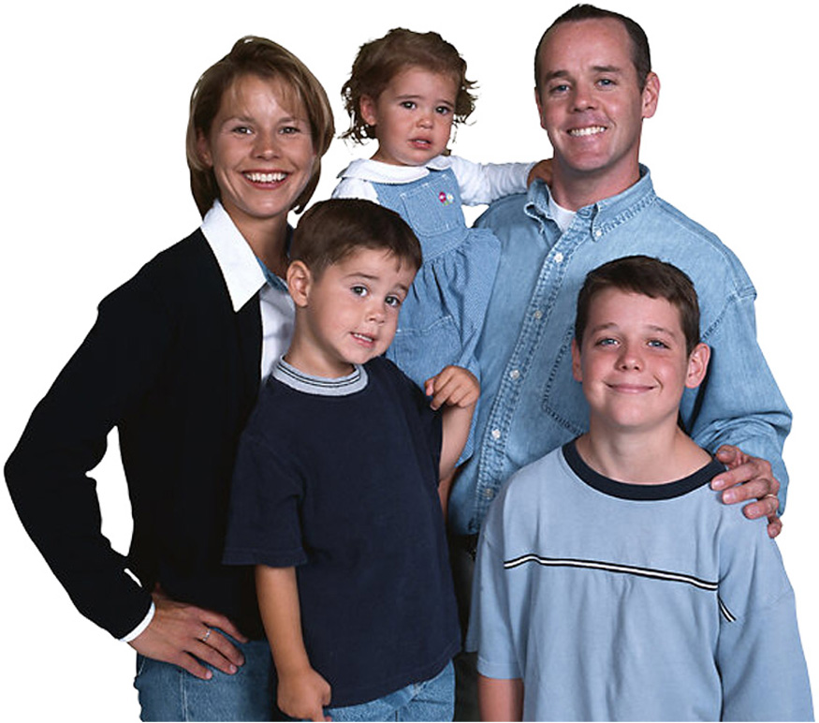
Who are You Talking to?
Family
Friends
Neighbors
Co-workers
Public officials

Slide 12
Your Messaging Goals
Have effective, credible language that you can use to talk about your life and experiences
Know how to use the message in different situations
Make it possible for more individuals, families and communities to get well

Slide 13
Personalizing the Message
There are many ways to develop a message
Messages aren’t designed as one-size-fits-all
Our message has been adapted for many different groups:
  Find your own voice by using these messages as a guide.

Slide 14
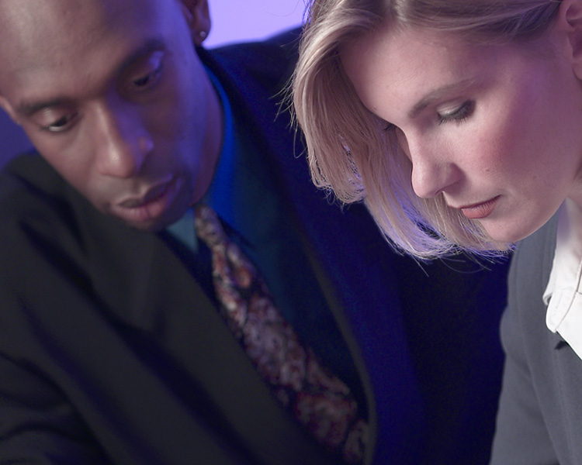
Your Frame of Mind
Speak with one voice
Make it personal; it adds credibility and breaks down misperceptions
Talk about your recovery, not your addiction – your recovery story

Slide 15

12-Step Anonymity
These messages don’t violate the traditions of your 12-step fellowship
Help us educate others in 12-step groups about their right to speak out!

Slide 16
Core Message
The Problem:
Need more opportunities for people to achieve long-term recovery
Need more effective treatment and recovery support services
There are discriminatory policies
The public and policymakers don’t know about the reality of recovery

Slide 17
Core Message
The Solution:
A strong national recovery movement organized at the local, state and federal levels
Putting a face and a voice on recovery to break down misperceptions that will change attitudes (stigma)
Advocating to change policies (discrimination)

Slide 18
Putting a Face & a Voice on Recovery: Message for a Person in Recovery
  I’m in long-term recovery which means...
  • Have not used alcohol or other drugs or gambled for x number years
  Long-term recovery has given me new hope and stability
  I’ve been able to create a better life for myself, my family and my community
  I’m speaking out (sharing this with you) so that others have the opportunity to achieve long-term recovery

Slide 19
Putting a Face & a Voice on Recovery:
Message for a Family Member
My family and I are in long-term recovery, which means …
(My son/daughter/husband/wife) hasn’t used alcohol or other drugs for x years
We’ve become healthier together, enjoying family life in our home
Long-term recovery has given me and my family new purpose and hope for the future
I want to make it possible for others to do the same

Slide 20
What’s Not in the Message and Why
I’m an addict
I’m a recovering addict
Addiction is a disease
Information about 12-step programs, for examples membership in AA or NA or Al-Anon
A “definition” of recovery

Slide 21
Words have Power
“Words have immense power to wound or
heal…The right words catalyze personal
transformation and offer invitations to
citizenship and community service. The
wrong words stigmatize and dis-empower.”
-William White
Author
and Recovery Advocate
“Words are important. If you want to care for something, you call it a ‘flower;’ if you want to kill something, you call it a ‘weed.’” – Don Coyhis
21

Slide 22

Thinking about Language
Words/Concepts We Need to Abandon
  Abuse
  Self-Help
  Untreated Untreated Addicts
  The Language of Self-Pity
Words/Concepts to Discuss and Debate
  Treatment Works
  Consumer
  Stigma, Enable, Relapse
  Recovering/Recovered

Slide 23
Thinking about Language
Words/Concepts We Need to Elevate and Celebrate
  Recovery, Recovery Community/ Communities of Recovery
  Advocacy, Sustainability
  Recovery Support Services/
  Recovery Coach
  Recovery-Oriented Systems of Care
  Living Proof
  Story
  Responsibility, Gratitude, Service

Slide 24
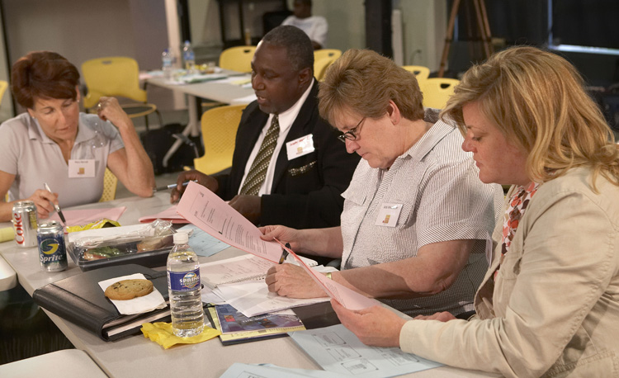
Tried, True and Tested
Be confident, people all across America are using this messaging
Thousands of people have been trained and are using recovery messaging
IT WORKS!

Slide 25
Faces & Voices Message Goals
Expand opportunities for recovery
Mobilize and organize the recovery community to advocate for own rights and needs
Break down discriminatory barriers
Build our national recovery advocacy movement
Achieve a just response to addiction as a health crisis

Slide 26
When can I Use the Message?
When talking to your family, friends and neighbors
When writing (articles, newsletters, blogging, etc.)
When talking to elected officials, public policy makers and others in government
When being interviewed or speaking in public
ALWAYS!

Slide 27
Recovery Messaging Resources
Recovery Messaging from Faces & Voices of Recovery
Recovery Messaging Questions & Answers
The Tip Sheet for Media Interviews
Our Stories Have Power DVD featuring interviews by people in recovery, family members and friends

Slide 28
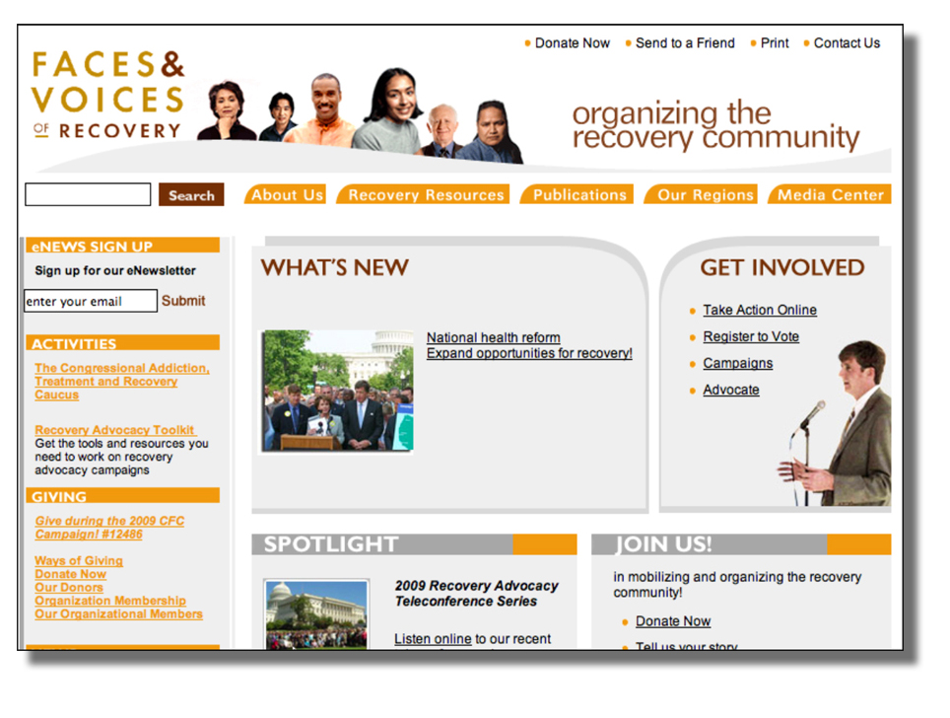
Faces & Voices of Recovery Website
28

Slide 29
Summary
Use Faces & Voices recovery messaging to tell your recovery story
Make it personal
Use your message in all parts of your life with
    Family and friends
    Neighbors and co-workers
    Always!

